Slide 1

Upload of MEDITS data
1st Training
18th September 2024
W. Zupa, I. Bitetto

Slide 2
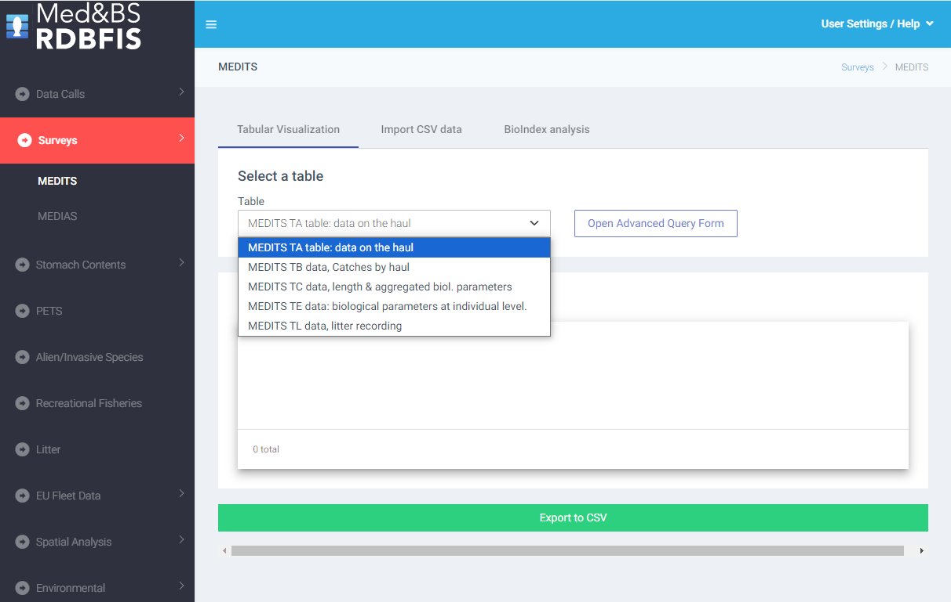

Slide 3
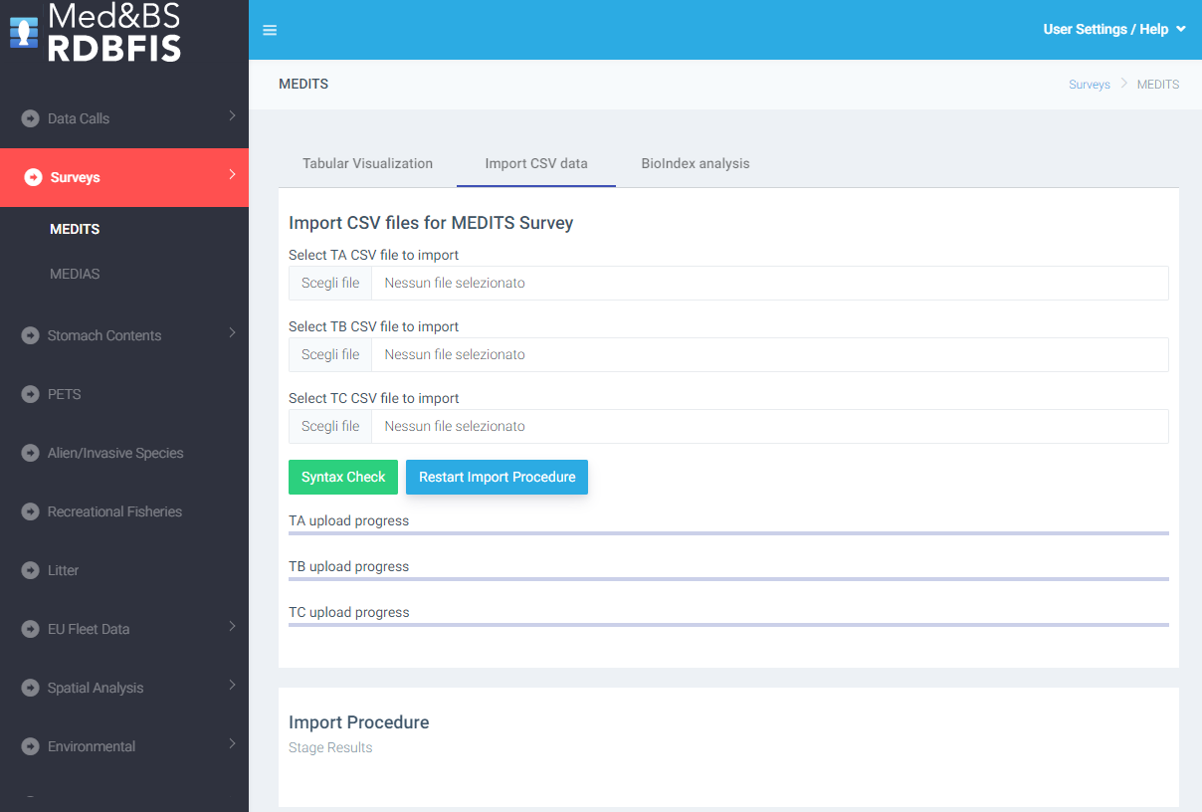

Slide 4
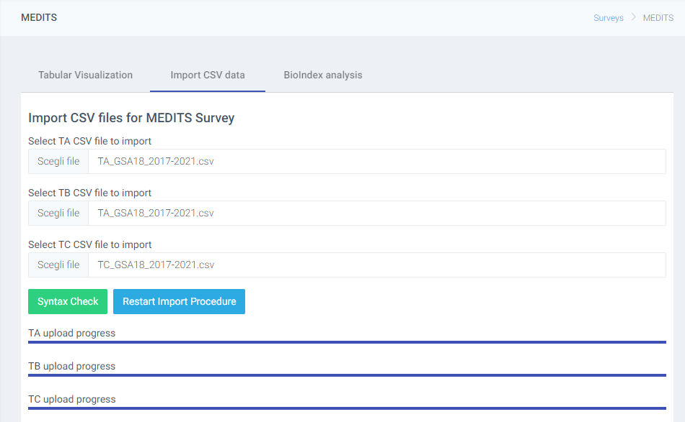
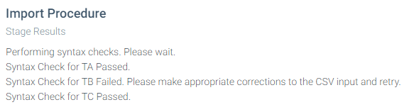
Data table not consistent with expected data

Slide 5
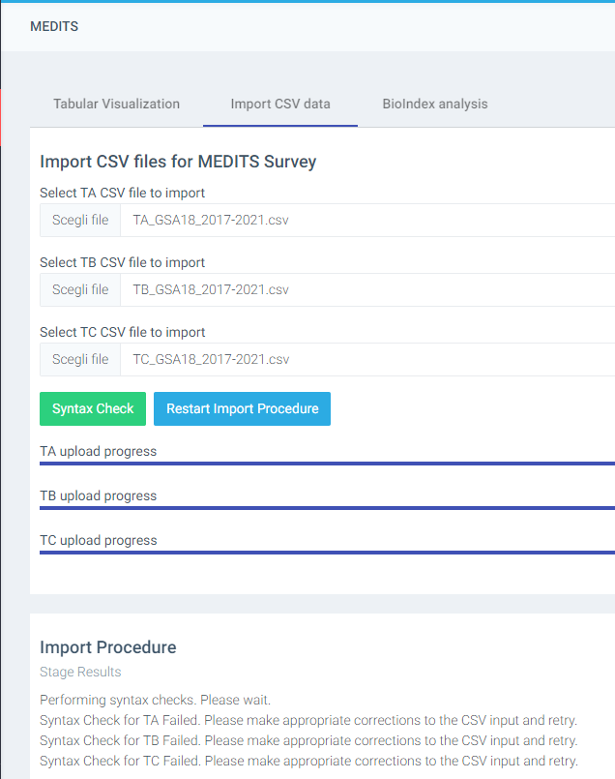
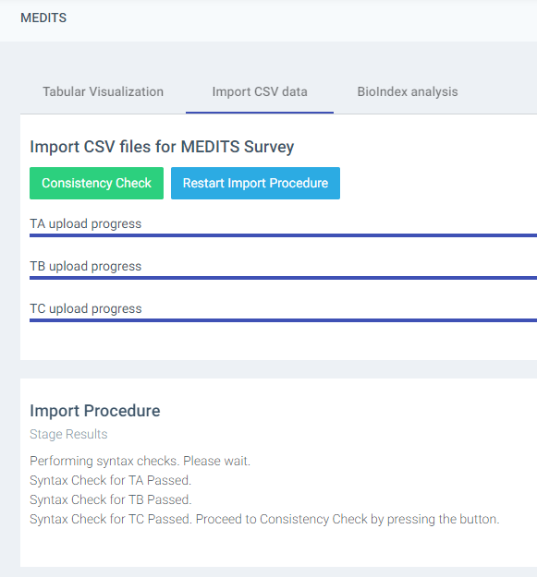
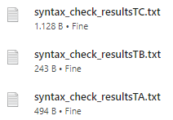

Slide 6
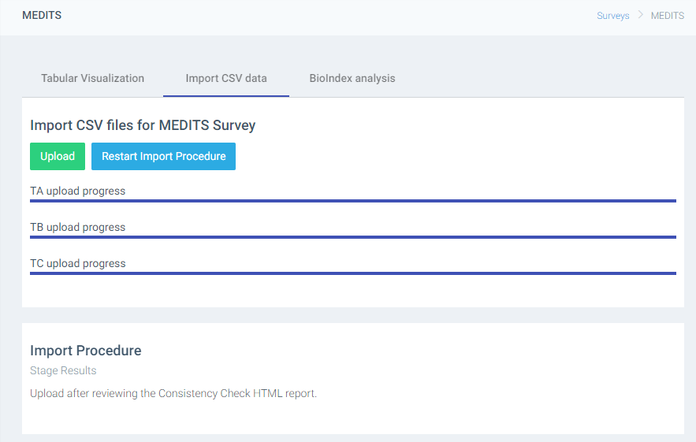
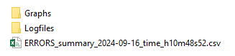
the outputs of the analysis are saved in a zip file containing all the results

Slide 7

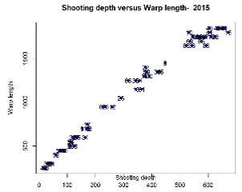
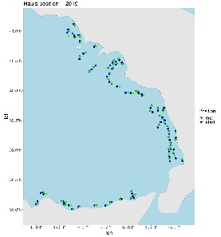
Mean features
Input: Exchange data tables in .csv format (TA, TB and TC, TE, TL) and additional tables from MEDITS manual (TM list, maturity scales table, stratification, etc..)
Output: Report of errors, Text file (Logfile.dat) with the outcome of each check and errors/warnings specifications and plots for qualitative controls.
Inputs
Outputs
haul____
catch ____
Sequence of the function calls in RoME
Check duplicated records on TX files
Check quasi-identical records on TX files
Check AREA and YEAR fields are the same for all the files
Check dictionary on TX files
Specific checks on TA
Specific checks on TB
Specific checks on TC
Specific checks on TE
Specific checks on TL
Cross checks
biological ____
Logfile
____
species
____
maturity
____
strata
___
RoME detects errors, then is up to the final user to correct them
size
___
Supplementary tables

Slide 8

##################################################################
# RoME v.0.1.38 R Code to Perform Multiple Checks on MEDITS Survey Data
# W. Zupa, I. Bitetto, M.T. Spedicato
#
# In case of use of the software, the Authors should be cited.
# If you have any comments or suggestions please contact the following
# e-mail address: zupa@coispa.it
#
# This program is free software; you can redistribute it and/or
# modify it under the terms of the GNU General Public License
# as published by the Free Software Foundation; either version 2
# of the License, or (at your option) any later version.
#
# This program is distributed in the hope that it will be useful,
# but WITHOUT ANY WARRANTY; without even the implied warranty of
# MERCHANTABILITY or FITNESS FOR A PARTICULAR PURPOSE. See the
# GNU General Public License for more details.
##################################################################
Version 0.1.38
NEW FEATURES
Completely updated version, compatible with the more recent versions of R software and dependencies
Multiplatform (Windows and Linux for RDBFIS)
67 standalone check functions
Documentation embedded in the package
Runs embedded in RDBFIS and stand-alone
Improved quality of plots and maps;
Specific functions for RDBFIS
RoMEcc (and RoMEBScc) to analyse the MEDITS tables without interruption and report all the errors occurred (error report + logfile)
all the outputs of the analysis are also stored in a local zip file
Environment
R version > 4.1.2
Rstudio: v. 2022.12.0
License: GPL-3

Slide 9
Report of the errors
errors | check type | table | variable | year
 | Check Headers | TA | NA | NA
 | Check Headers | TB | NA | NA
 | Check Headers | TC | NA | NA
 | Check CLASS | TA | NA | NA
 | Check CLASS | TB | NA | NA
 | Check CLASS | TC | NA | NA
 | Check YEAR | ALL | NA | NA
 | Check TYPE_OF_FILE | ALL | NA | NA
 | Check identical record TA | TA | NA | 2015
 | Check identical record TB | TB | NA | 2015
 | Check identical record TC | TC | NA | 2015
 | Check quasi-identical record in TA | TA | NA | 2015
 | Check quasi-identical record in TB | TB | NA | 2015
 | Check quasi-identical record in TC | TC | NA | 2015
 | Check consistency of area TA, TB, TC, TE, TL | ALL | NA | 2015
 | Check dictionary | TA | COUNTRY | 2015
 | Check dictionary | TA | AREA | 2015
errors | check type | table | variable | year
 | Check Headers | TA | NA | NA
 | Check Headers | TB | NA | NA
 | Check Headers | TC | NA | NA
X | Check CLASS | TA | NA | NA
 | Check CLASS | TB | NA | NA
 | Check CLASS | TC | NA | NA
X | Check YEAR | ALL | NA | NA
Output in the console
…
[1] Check presence in TB of TC species in progress...
[1] Check presence in TB of TC species successfully completed!
[1] Check correctness of the number per sex in TB in case of sub-sampling in TC in progress...
[1] Check correctness of the number per sex in TB in case of sub-sampling in TC successfully completed!
[1] Check on date by haul TB in progress...
[1] Check on date by haul TB successfully completed!
[1] Check on date by haul TC in progress...
[1] Check on date by haul TC successfully completed!
[1] All the checks have been performed!
Check presence of lengths for G1 and G2 Medits species in TC | TC | NA | 2015
Check presence in TB of TA hauls | TB-TA | NA | 2015
Check presence in TA of TB hauls | TA-TB | NA | 2015
Check presence in TC of TB target species | TC-TB | NA | 2015
Check presence in TB of TC species | TB-TC | NA | 2015
Check correctness of the number per sex in TB in case of sub-sampling in TC | TB-TC | NA | 2015
Check on date by haul TB | TA-TB | NA | 2015
Check on date by haul TC | TA-TC | NA | 2015

Slide 10
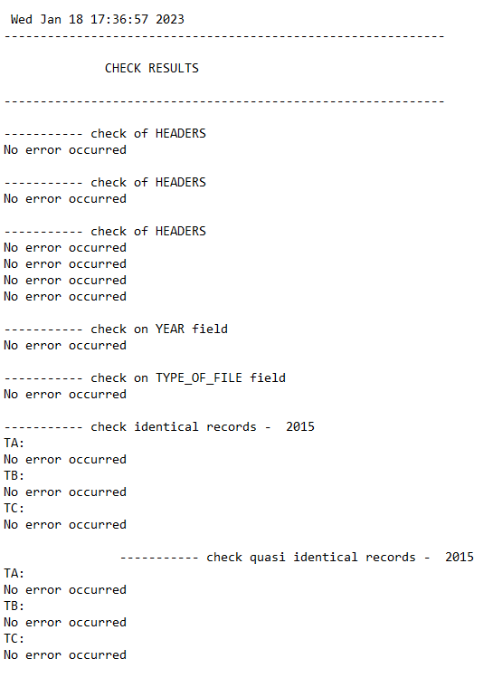
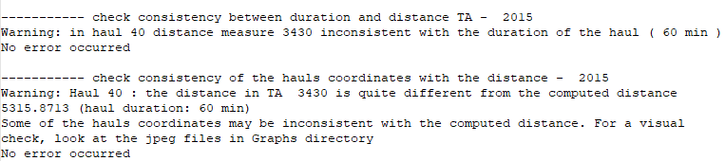
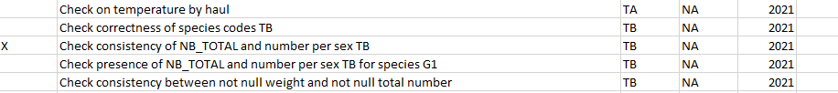
logfile
Warning
Error
logfile
Report of the errors

Slide 11
The RoME v.0.1.38 package:
Open source code, publicly available on GithHub
Can be used with 2 different functions: RoMEcc and RoMEBScc
Supports the fast identification of errors and inconsistencies in survey data
Allow to harmonize the MEDITS survey data quality checks among the Countries
Designed to facilitate a more systematic and well-defined schedule for quality checks prior the relevant data calls
Globally increases the data quality

